Slide 1
MFA Arts Leadership and Cultural Management @ UConn

Slide 3
Overview
The Master of Fine Arts (MFA) in Arts Leadership and Cultural Management prepares individuals to take on leadership and management roles in arts, culture, and creative sectors.
Internships with leading organizations and other work/learn opportunities are integral to the program.
As the demand for individuals to take on leadership roles in the creative sector grows, graduates of this program will be able to meet the challenge in for profit, non-profit, and governmental arenas.
We provide you with the practical and theoretical contexts for leading arts organizations to greater success.

Slide 4
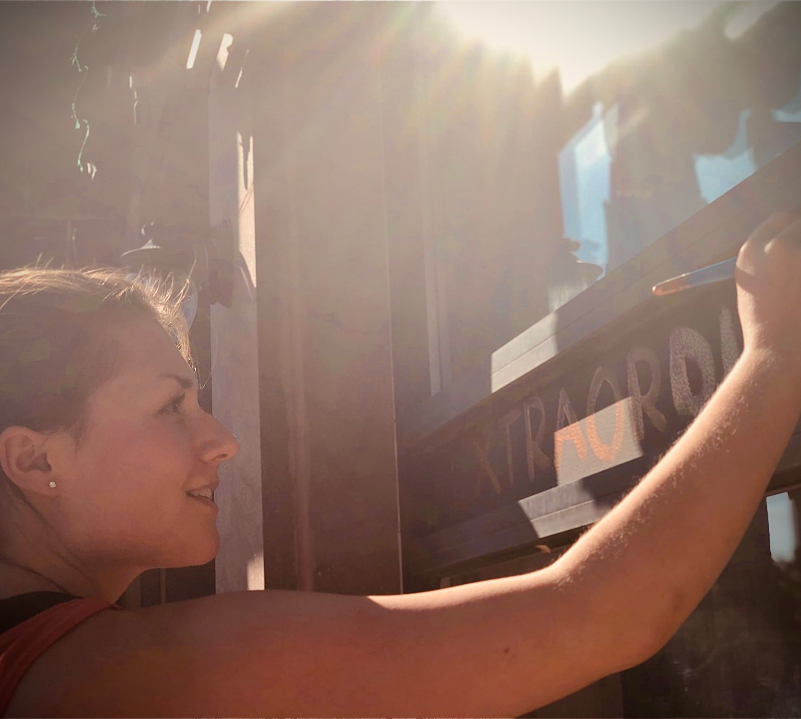
What You Will Learn
Students acquire skills for leading the financial, budgetary, fundraising, advocacy, and marketing aspects of creative sector organizations, combined with entrepreneurial know-how.
Managing resources effectively for arts organization success
Integrating legal, philosophical, and community service perspectives to address an organization’s needs.
Coursework emphasizes practical application combined with theoretical reflection, critical inquiry, and higher order decision-making abilities.

Slide 5
Why Earn an MFA in Arts Leadership
Earning an MFA prepares you for leadership roles in the arts and culture sector including nonprofit, for profit, and public enterprises.
This program will help you more effectively evaluate, market, and promote arts organizations.
Employers in the arts sectors prefer those with higher education training targeted to their sector.
This program helps you translate your passion for the arts and its role in society into arts programming that matters.

Slide 6
Plan of Study
1st Year: Fall Semester
DRAM 5110 Core Concepts in Arts Leadership and Cultural Management
DRAM 5120 Financial Management for the Arts
DRAM 5121 Governance & Leadership in the Arts
DRAM 5114 Studio 1
1st Year: Spring Semester
DRAM 5123 Marketing the Arts
DRAM 5122 Fundraising and Development for the Arts
Elective
DRAM 5115 Studio 2

Slide 7
2nd Year: Fall Semester
PP 5328 Business Functions of Nonprofit Orgs
DRAM 5124 The Arts in Civil Society
Elective
DRAM 5116 Studio 3
2nd Year: Spring Semester
DRAM 5111 Professional Internship

Slide 8
3rd Year: Fall Semester
DRAM 5112 Advanced Topic Research
DRAM 5125 Law and the Arts
DRAM 5117 Studio 4
3rd Year: Spring Semester
DRAM 5113 MFA Project
DRAM 5118 Studio 5

Slide 9
Meet Some of Our Faculty: Constance DeVereaux, PhD
Constance DeVereaux is the director of Arts Leadership and Cultural Management at University of Connecticut, and Associate Professor in Residence in Department of Dramatic Arts.
She is internationally recognized for her contributions to the field of arts and cultural management as a researcher, educator, and scholar. She has created and led numerous university programs in arts and cultural management in the US and abroad and has designed curriculum for undergraduate and graduate courses focusing on leadership and management of arts and cultural organizations.
Learn more about Dr. DeVereaux’s work here.

Slide 10
Professor Heather M. Kitchen
Heather M. Kitchen is a theater administrator with more than 40 years of professional experience in strategic and program planning, fundraising, financial analysis, board development, and union negotiations.
During her illustrious career, Ms. Kitchen has led several performing arts organizations in both the United States and Canada. She has also had a noted international career in production and stage management.
Ms. Kitchen has served as Managing Director of Dallas Theater Center (DTC), Executive Director of American Conservatory Theater (A.C.T.), General Manager of the Citadel Theatre, and Production Manager at Theatre New Brunswick. She worked in stage management for 15 years in many of the major regional theaters across Canada, including the Stratford Festival, The Neptune Theatre, and Canadian Stage Company.
She is a noted teacher of stage, production, and theater management, having taught and guest lectured at more than 20 universities and colleges throughout Canada and the United States.

Slide 11
Johanna Schindler, PhD
Johanna Schindler was trained as a cultural scholar and arts manager (Halle / Germany, Paris, and Friedrichshafen / Germany) and wrote her doctoral thesis on artistic research.
She has worked as a curatorial assistant at Kunstmuseum Liechtenstein, as a manager of the International Association of Curators of Contemporary Art, as a research fellow at Zeppelin University, Germany, as well as a researcher and coordinator at Haus der Kulturen der Welt, Berlin.
Since 2019, she is the managing editor of the Journal of Cultural Management and Cultural Policy, a reviewer for the Journal for Artistic Research, and a freelance translator, editor, and project adviser in the arts and cultural fields.

Slide 16
Tuition/Fees
$825 per credit, or $2,475 for a 3-credit course.
Learn more at: https://grad.uconn.edu/financing/tuition-and-fees/

Slide 17
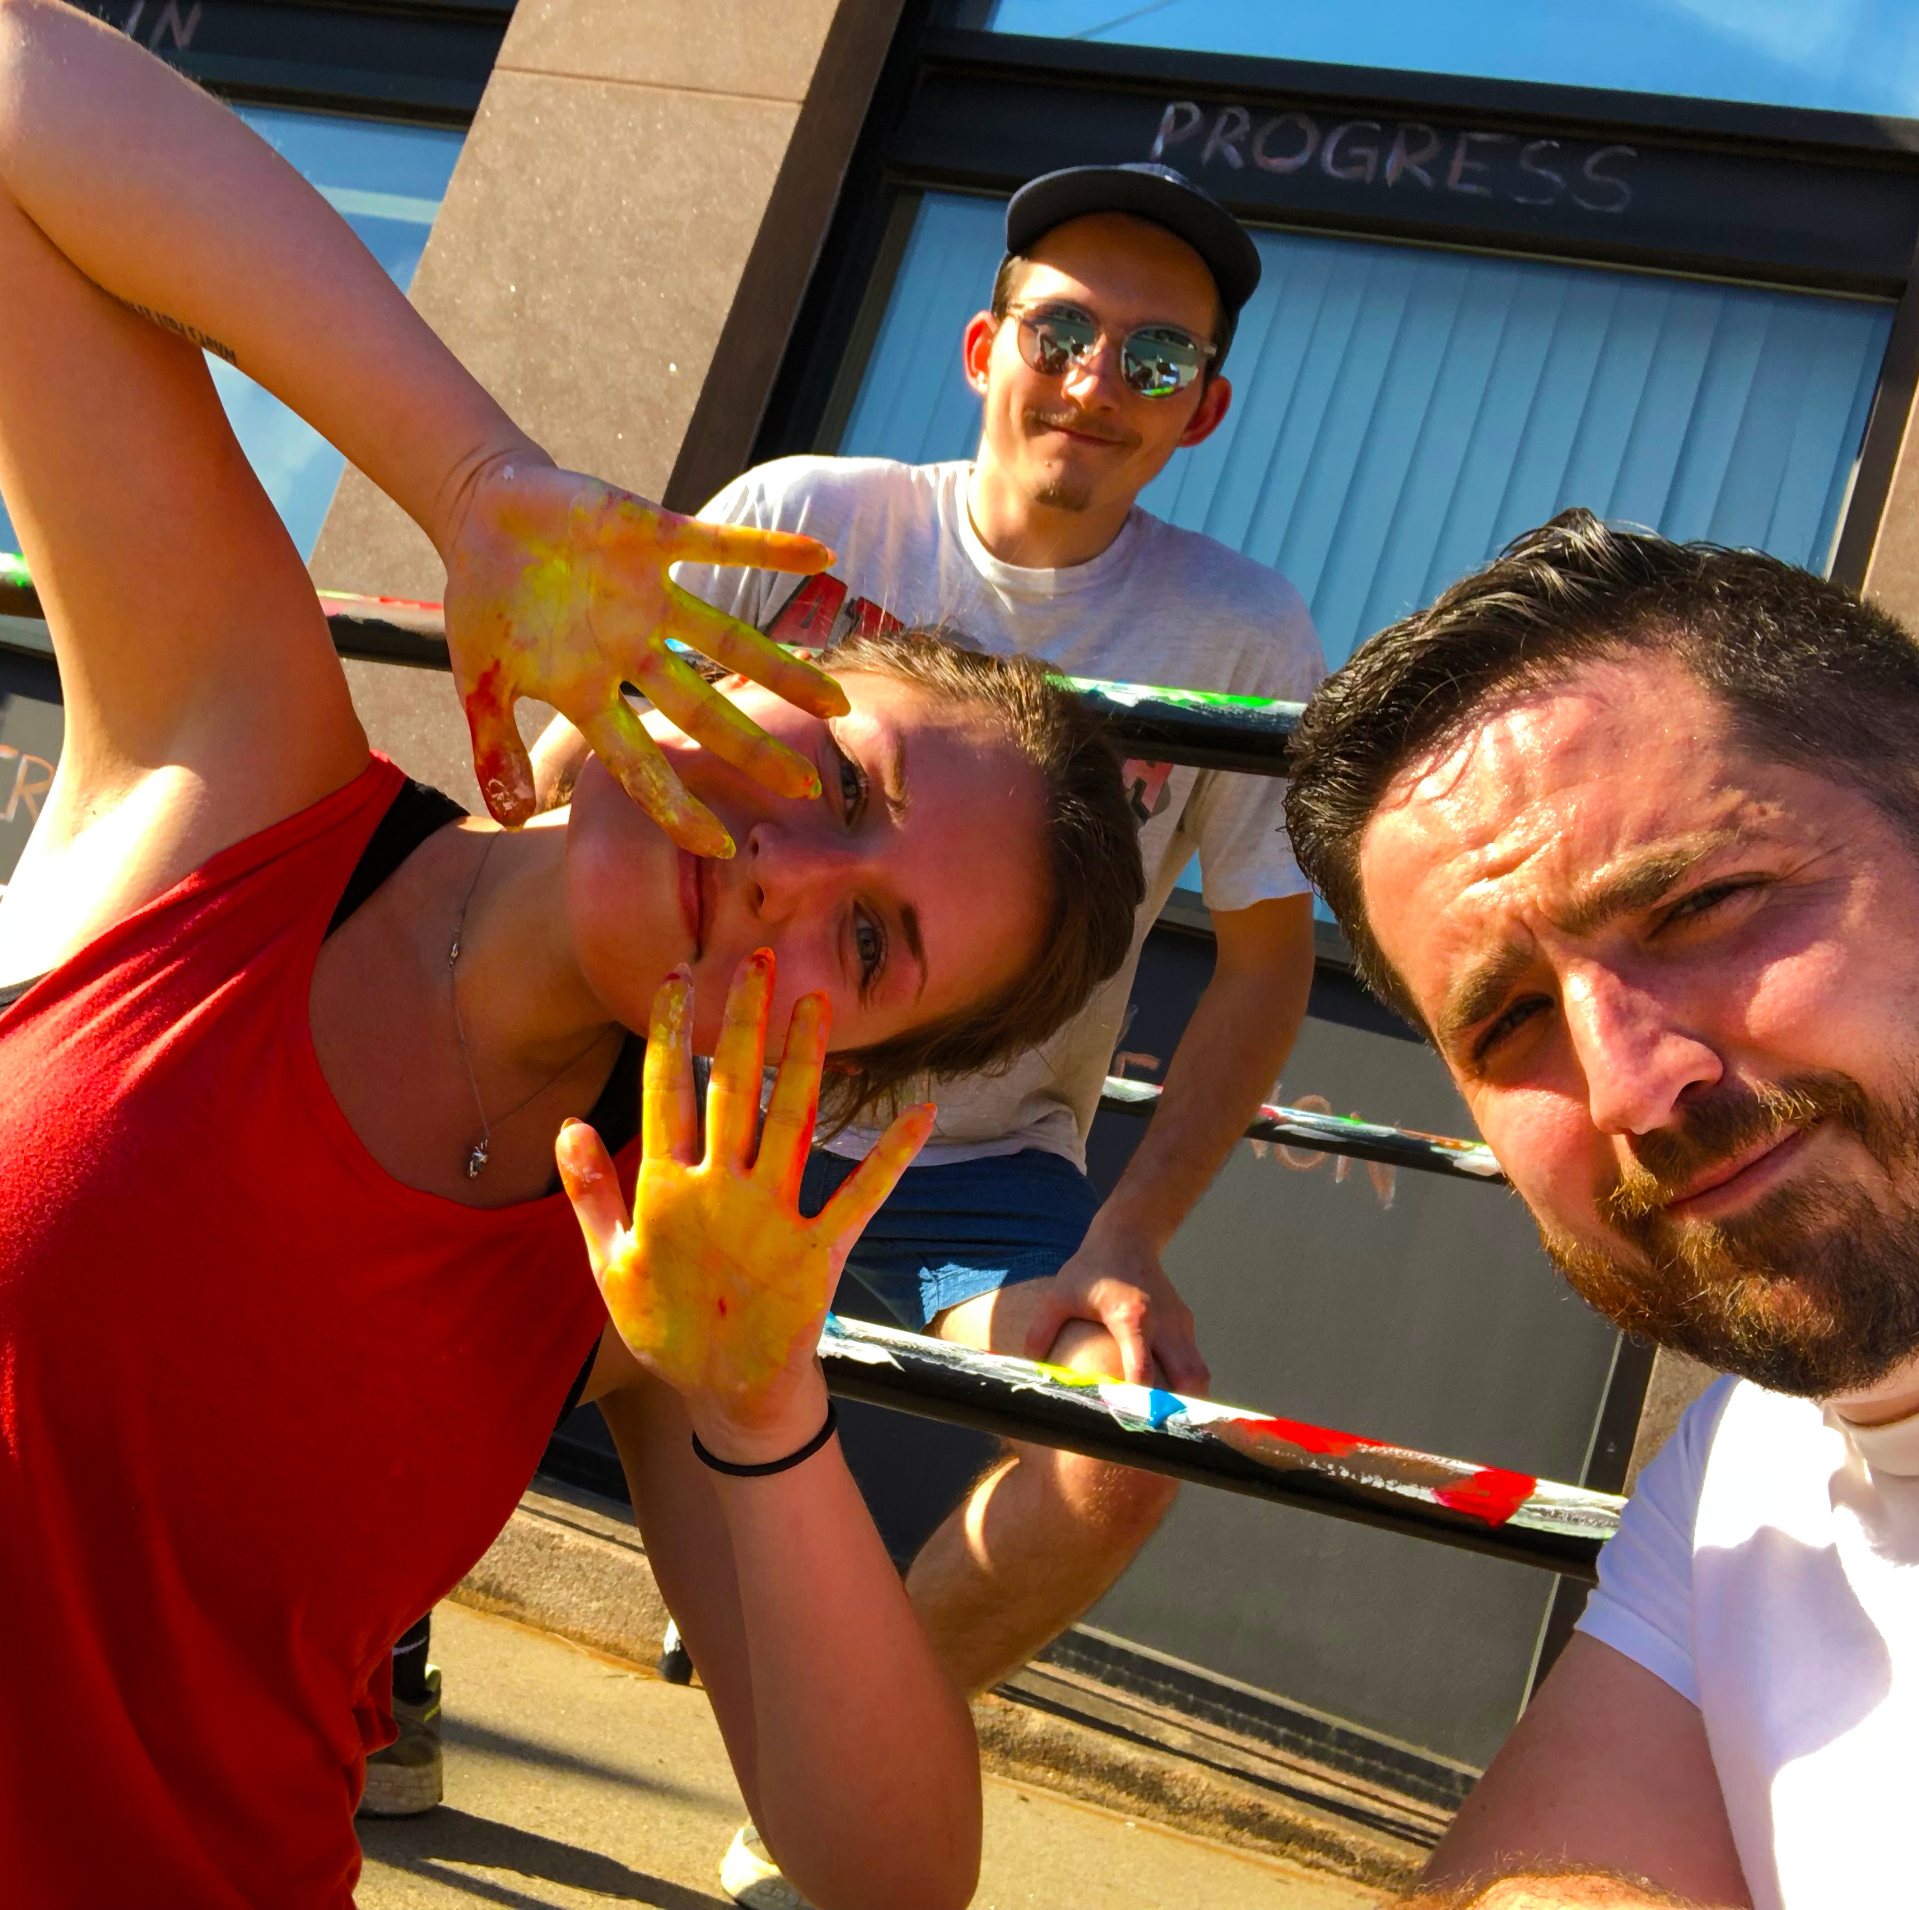
MFA Culminating Project
All MFA Students will complete their degree with a project of their choosing.
Work in close mentorship with ALCM faculty
Learn and apply innovative research and implementation tools to solve real world problems
Examples of past projects:

Slide 18
MFA Culminating Project Examples
How Disaster Planning Leads to Better Management of Small Museums
Survey Research and Design for Arts Organizations
Using Data Visualization for Better Arts Organization Decision Making
Nurturing Artistic Socialization: A Study of Millennial Moms

Slide 19
Graduate Assistants
All accepted applicants to the MFA program are automatically considered for competitive graduate assistant positions (dependent on funding)
Graduate assistants receive a full tuition waiver and stipend
Graduate assistants work up to 10 hours a week at selected organizations on campus

Slide 20
Application Requirements
Complete UConn Application
Official transcripts
3.0 Minimum Undergraduate GPA
3 Letters of Recommendations
Resume
Personal Statement
No GRE Required
$75 non-refundable application fee
Apply now at https://grad.uconn.edu/admissions/apply-to-uconn/

Slide 21
Learn More At:
The Graduate Schools Academic Calendar: https://registrar.uconn.edu/academic-calendar/
Graduate Admission: https://grad.uconn.edu/admissions/
Tuition and Fees: https://grad.uconn.edu/financing/tuition-and-fees/

